Slide 1

SkyBook – Flight Booking System
Koushal – 2520030009
Varshith – 2520080016

Slide 2
Abstract:-
Air travel is widely used but online booking platforms are often complex and hard to navigate for everyday users SkyBook is a beginner-friendly web-based flight booking system that simplifies the entire search and reservation process.
Users can search flights by source, destination, date and class with real-time results Key features include seat selection, booking summary, mock payment, e-ticket generation and booking history Built using React.js, Node.js, Express.js, Bootstrap and MySQL Designed as a complete full-stack application split across 5 core modules.

Slide 3
Module Distribution & Mapping
Module | Goal
User Auth & Notifications | Secure login, register and real-time alerts
Flight Search & Filters | Search flights and filter by price, airline, stops
Seat Selection & Booking Summary | Pick seat and review booking before payment
Payment & E-Ticket | Mock payment and auto-generate downloadable ticket
Booking History & Admin Dashboard | Track bookings and manage system as admin

Slide 4
Overall Implementation & Technologies Used
How it works (flow): Homepage → Search Flights → View & Filter Results → Select Seat → Review Summary → Payment → E-Ticket Generated
React.js, React Router, Context API
VS Code, npm, javascript
Html , css

Slide 5
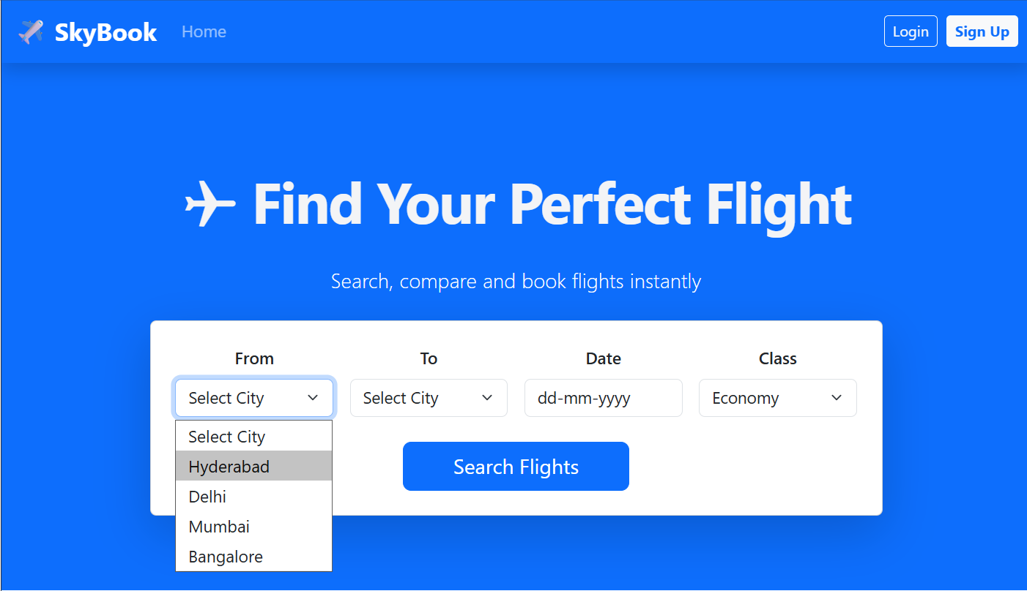
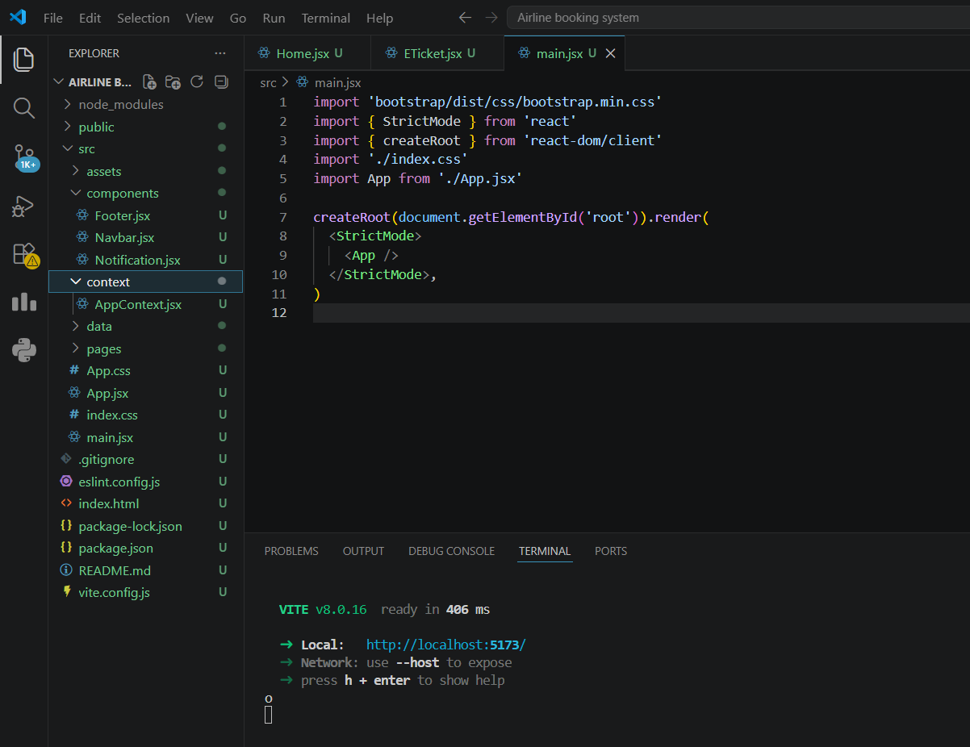
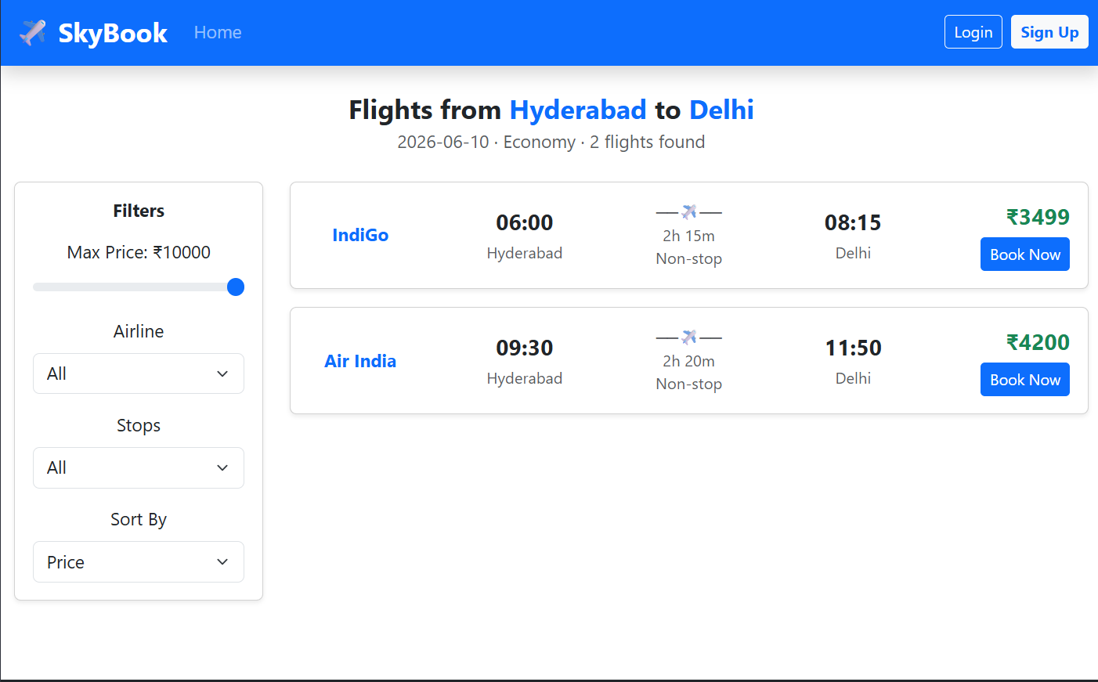
Code and Output:-

